Slide 1
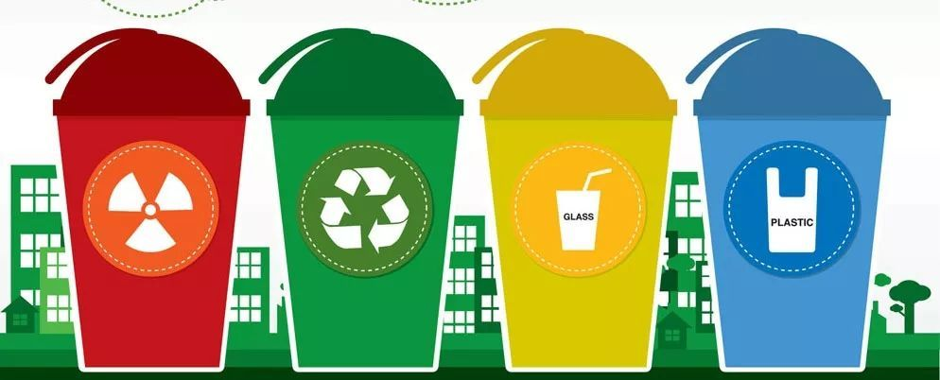
Garbage Classification
Image Classification Based on Deep Learning
MSBA 7011 – Group A9
15/ 04/ 2020

Slide 2
Work Allocation
No. | Name | UID | Duties
1 | Chen Jiaojiao | 3035675579 | Coding, Modeling, Report Writing
2 | Tang Xiaojun | 3035675048 | Data and Paper Search, Report Writing
3 | Wang Yang | 3035675282 | Report Writing
4 | Xie Siyang | 3035675323 | Coding, Modeling, Files Sorting
5 | Yan Shujie | 3035674460 | Report Writing
6 | Zhang Xiao | 3035675634 | PPT Slides Making, Video Clipping
Wang Yang:
Zhang Xiao:

Slide 3
CONTENTS
1. Introduction
2. Exploratory data analysis
3. Modeling
4. Results
5. Summary

Slide 4
Part 1
Introduction

Slide 5
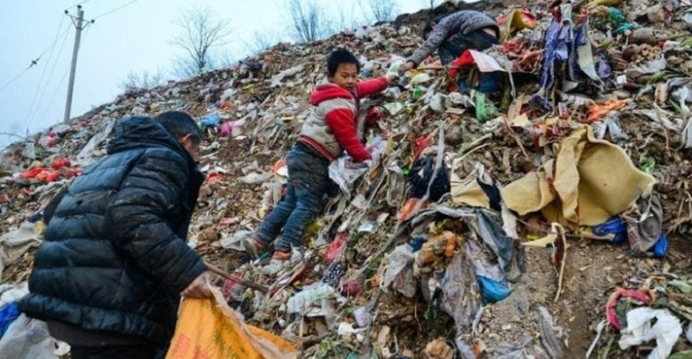
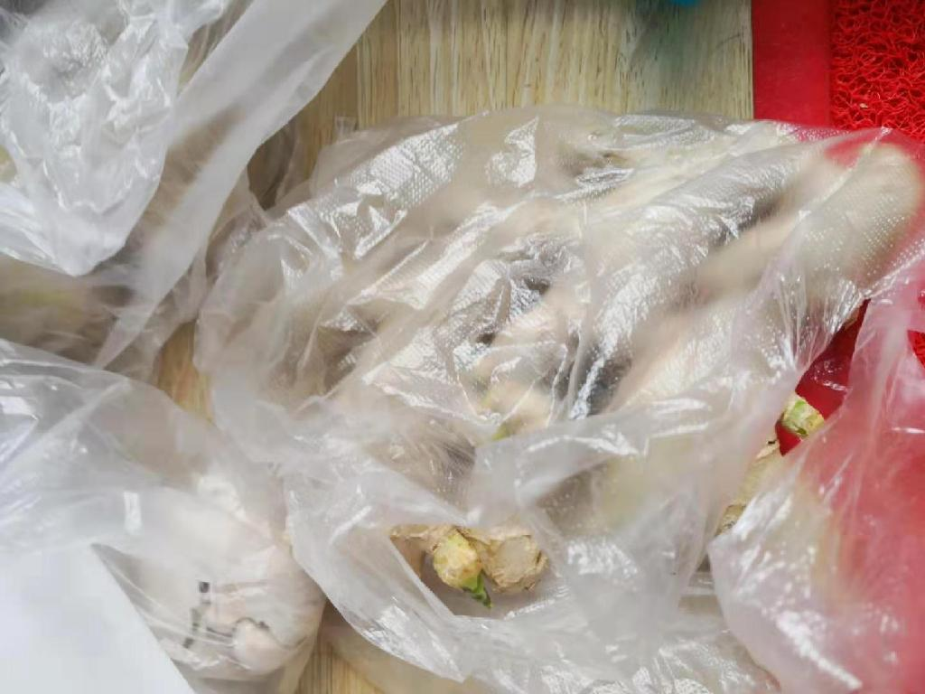
Introduction
Background of
garbage classification
By 2022, every city in China at the prefecture level and above should have at least one district where all household garbage is classified, and by 2025 they should have their own household garbage sorting and disposal systems. Garbage classification has become a common topic that people would encounter in their everyday life.
Sort manually
Shang Hai
Sort by AI
“Other garbage- stained plastic”

Slide 6
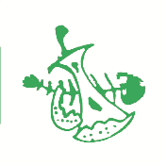



Introduction
Classification Rule
Other Waste
Kitchen Waste
02
In addition to the above three types of garbage, other household garbage, such as diapers, dust, cigarette butts, disposable snack boxes, damaged flower pots and dishes, wallpaper, etc.
Perishable garbage generated by households and individuals, including leftovers, leftovers, vegetable leaves, peels, eggshells, tea residues, soup residues, bones, waste food, and kitchen waste, etc.
03
01
Recyclable
04
Harmful Waste
Waste suitable for recycling and resource utilization, including waste glass, metal, plastic, paper, fabric, furniture, electrical and electronic products, and annual flowers and oranges, etc.
Wastes that cause direct or potential harm to human health or the natural environment and should be specially disposed of, including waste batteries and waste fluorescent tubes, etc.
6

Slide 7
Part 2
Exploratory data analysis

Slide 8
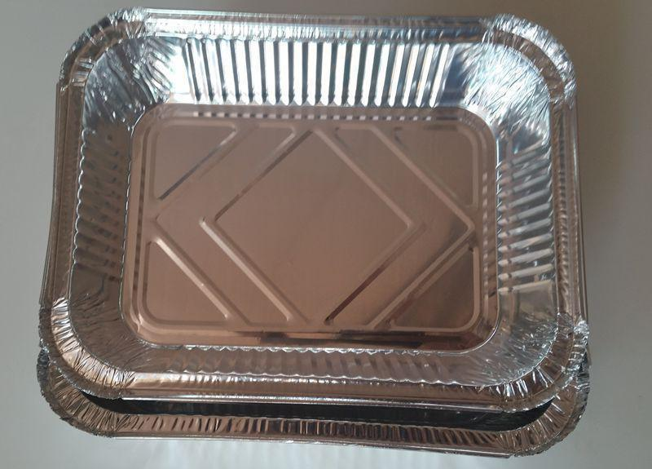
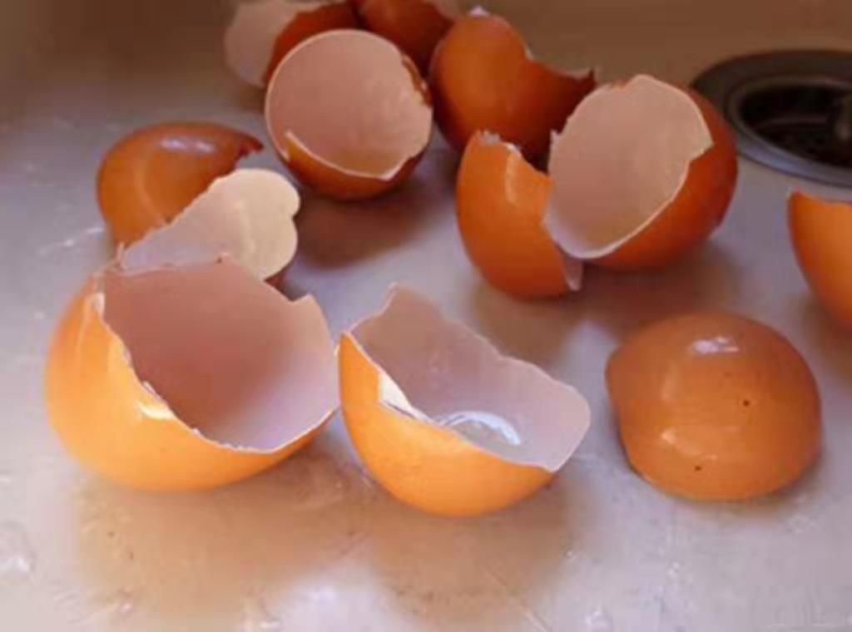
Data
Training Set
1
14802
78%
4165
22%
Format:
garbage images (.jpg)
and corresponding label files (.txt)
Source:
https://modelarts-competitions.obs.cn-north-1.myhuaweicloud.com/garbage_classify/dataset/garbage_classify.zip
Label: 0
Testing Set
2
Format:
garbage images (.jpg)
and corresponding label files (.txt)
Source:
https://pan.baidu.com/s/1SulD2MqZx_U891JXeI2-2g password: epgs
Training Set
Testing Set
Label:12

Slide 9
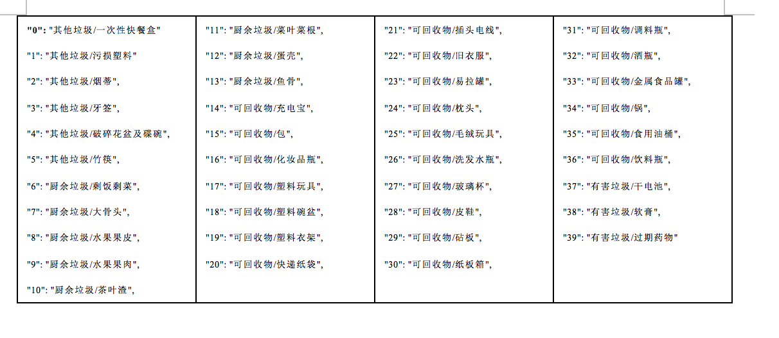
Data
Classification Rule
3
Format:
Jason file
Content:
4 categories of garbage, and 40 sub-categories or classes

Slide 10
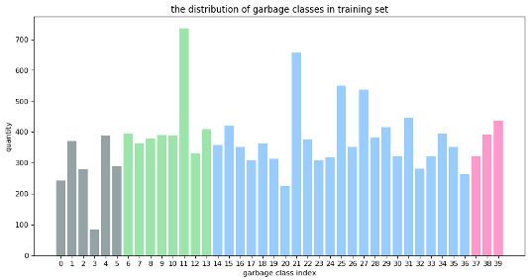
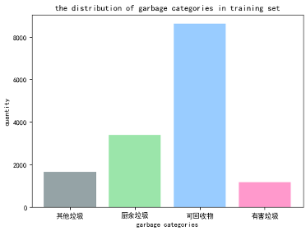
EDA
The Distribution of Garbage Classes and Categories in Training Set

Slide 11
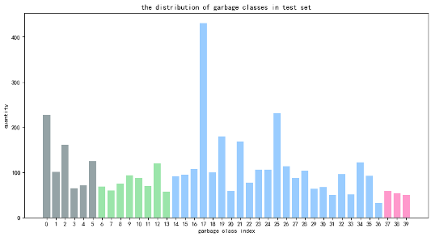
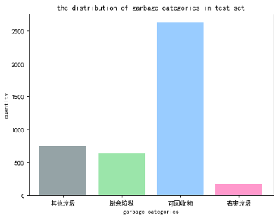
EDA
The Distribution of Garbage Classes and Categories in Testing Set

Slide 12
Part 3
Modeling

Slide 13
Method and Platform
Method
To use Pytorch in Python to train and test our convolutional neural network
To choose transfer learning of Resnet18, Resnet50 and ResNext50(32x4d)
Platform
To use Google Colab (GPU mode) to load images and train above models after data preparation.
TO BE CONTINUED

Slide 14
Data Preparation and Loading
Randomly crop the into size 256
Flip part and crop into size 224
Convert them into tensor type
Normalization
Batch size: 128
Input shape：
[128, 3, 224, 224]
Loading
Testing Set
Augmentation
Training Set
Augmentation
Final
Settings
Create 40 folders denoted as 40 classes of trash
Move the images to corresponding folders
Resize and crop into size 256 and 244 respectively
Make conversion and normalization

Slide 15
Modeling
Select the best network among ResNet18, ResNet50 and ResNext-50
Model | ResNet-18 / ResNet-50 / ResNext-50
Optimizer | Adam |  |  | SGD
Learning rate | 0.01 | 0.001 | 0.0001 | 0.01 | 0.001 | 0.0001
Initialize the network with a pretrained network
Freeze the parameters firstly
Improve the performance by tuning optimizer and learning rate parameters, fixing weight decay = 5e-4.
Try finetuning the convnet (not freeze the parameters) after selecting the best network

Slide 16
Part 4
Results

Slide 17
Results
Model | ResNet-18
Optimizer | Adam |  |  | SGD
Learning rate | 0.01 | 0.001 | 0.0001 | 0.01 | 0.001 | 0.0001
Testing accuracy (%) | 78.06 | 80.58 | 79.11 | 81.01 | 79.06 | 72.89
When freezing the parameters and training the models, we observe that ResNext-50 has the best performances, with test accuracy of around 85%.
Model | ResNet-50
Optimizer | Adam |  |  | SGD
Learning rate | 0.01 | 0.001 | 0.0001 | 0.01 | 0.001 | 0.0001
Testing accuracy (%) | 80.93 | 84.48 | 84.93 | N/A | 84.22 | 84.98
Model | ResNeXt-50
Optimizer | Adam |  |  | SGD
Learning rate | 0.01 | 0.001 | 0.0001 | 0.01 | 0.001 | 0.0001
Testing accuracy (%) | N/A | 84.43 | 84.98 | N/A | 84.73 | N/A

Slide 18
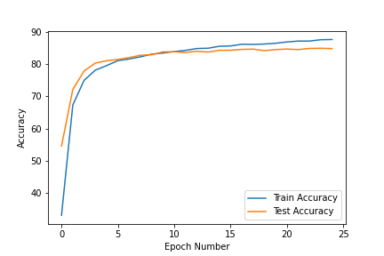
Results
Model | ResNeXt-50
Optimizer | Adam |  |  | SGD
Learning rate | 0.01 | 0.001 | 0.0001 | 0.01 | 0.001 | 0.0001
Testing accuracy (%) | N/A | 84.43 | 84.98 | N/A | 84.73 | N/A
ResNeXt50 (Adam, learning rate=0.0001)
ResNeXt50 (SGD, learning rate=0.001)

Slide 19
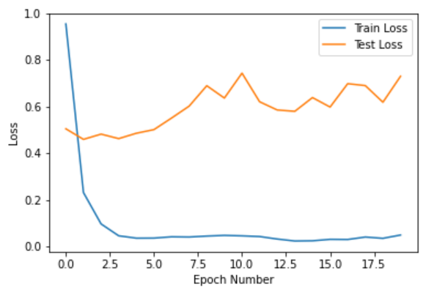
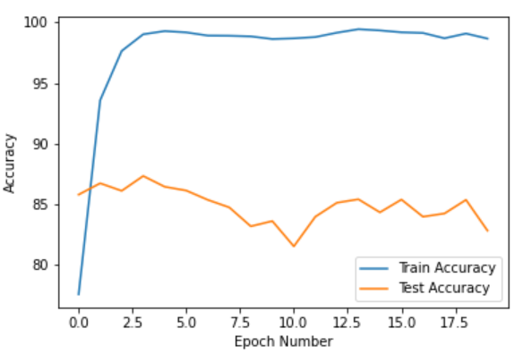
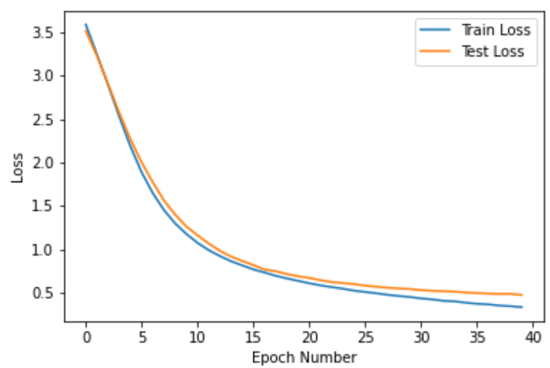
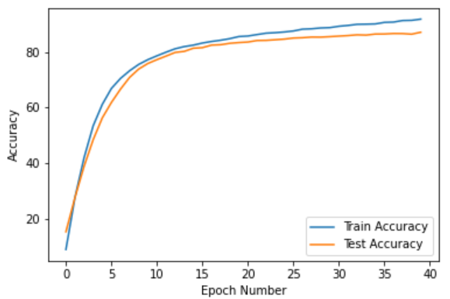
Results
finetuning the convnet on ResNext50
ResNeXt50 (Adam, learning rate=0.0001)
ResNeXt50 (SGD, learning rate=0.0001)
Model | ResNext50(32x4d)
Optimizer | SGD
Scenarios | Finetuning the convnet
Learning rate | 0.0001
Weight Decay | 5e-4
Epoch | 40
Testing accuracy (%) | 87.18%

Slide 20
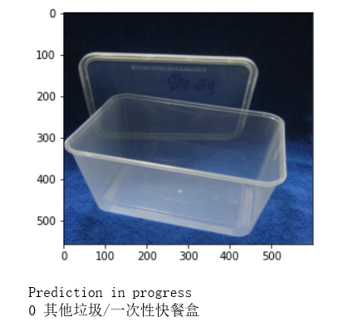
Results
Save the model parameters as ‘pth’ file for future prediction
Reload the model
Predict
Prediction Example

Slide 21
Part 5
Summary

Slide 22
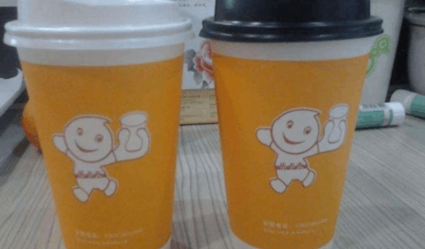
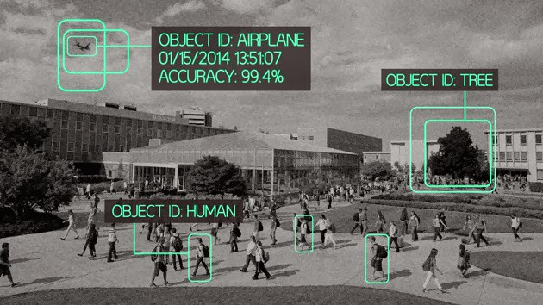
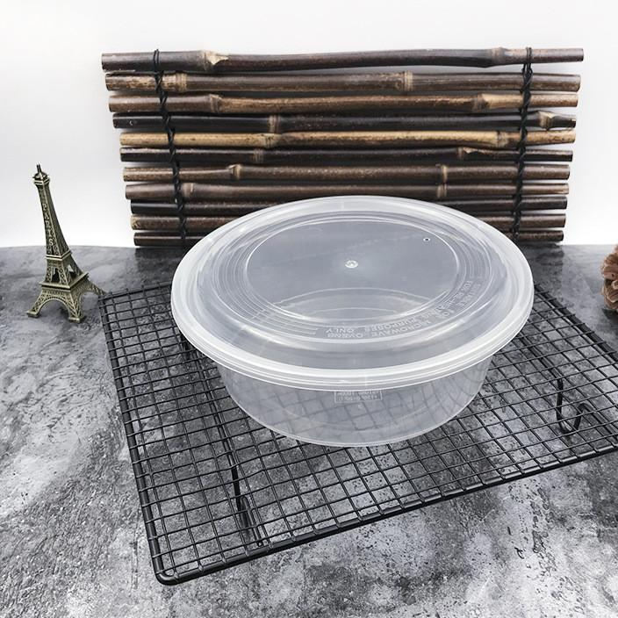
Limitations & Future Work
recognizing different components from a whole subject
Image recognition
disruptions in the picture

Slide 23
Summary
03
04
01
02
Model
Business
Global Environment
Data
Larger training set would be better
Potential in having less bias by increasing the complexity.
Reduced human labor;
Recyclable materials
Beneficial globally.
Notes:
so here’s a brief summary of the whole project. 87% testing accuracy was acceptable as quite a few Chinese residents got headache when they were required to classify the type of the garbage. But still, we believe there’s potential in the reducing both the variance and bias of the algorithm by including much more training samples or by increasing the complexity of the model.
For the business part, this model, if developed as a plug-in function of a garbage sorting machine, will definitely reduce the human labor of manual sorting. But thing is, we’re actually not sure if the recycling part is economically efficient as the reproduce process cost a lot based on the current technology. That’s also the reason why most of the products made of the recyclable materials are more expensive than the regular ones.
However, based on the fact that we produce about 3 billion tons of garbage every year and at least 33% have not undergone environmentally sound treatment, especially in some underdeveloped countries, garbage or wastes are actually jeopardizing the environment heavily. And more concern should be raised on this problem.
That’s the end of the project, thanks for your listening.

Slide 24
Thanks!

